Slide 1
Don’t Repeat Yourself

Slide 2
Don’t Repeat Yourself - Levels
Value
Instance field
Method
Class

Slide 3
10
10

Slide 4
// Init
for (int x = 0; x < 10; x++)
{
for (int y = 0; y < 10; y++)
{
// …
}
}

Slide 5
// Init
for (int x = 0; x < 10; x++)
{
for (int y = 0; y < 10; y++)
{
// …
}
}
// Logic
for (int x = 0; x < 10; x++)
{
for (int y = 0; y < 10; y++)
{
// …
}
}

Slide 6
// Init
for (int x = 0; x < 10; x++)
{
for (int y = 0; y < 10; y++)
{
// …
}
}
// Logic
for (int x = 0; x < 10; x++)
{
for (int y = 0; y < 10; y++)
{
// …
}
}

Slide 7
5
8

Slide 8

// Init
for (int x = 0; x < 8; x++)
{
for (int y = 0; y < 5; y++)
{
// …
}
}
// Logic
for (int x = 0; x < 8; x++)
{
for (int y = 0; y < 5; y++)
{
// …
}
}

Slide 9
public const int xDimension = 8;
public const int yDimension = 5;

Slide 10

public const int xDimension = 8;
public const int yDimension = 5;
// Init
for (int x = 0; x < xDimension; x++)
{
for (int y = 0; y < yDimension; y++)
{
// …
}
}
// Logic
for (int x = 0; x < xDimension; x++)
{
for (int y = 0; y < yDimension; y++)
{
// …
}
}

Slide 11
public class Die
{
public Die()
{
// …
}
public void Roll()
{
_faceValue = _gen.Next(6) + 1;
}
}

Slide 12
public class Die
{
private int _noOfFaces;
public Die(int noOfFaces)
{
_noOfFaces = noOfFaces;
}
public void Roll()
{
_faceValue = _gen.Next(noOfFaces) + 1;
}
}

Slide 13
public class Human
{
private double _weight;
private double _height;
private double _bmi;
…
public double BMI
{
get { return _bmi; }
set { _bmi = value; }
}
}

Slide 14
public class Human
{
private double _weight;
private double _height;
private double _bmi;
…
public double BMI
{
get { return _weight / (_height * _height); }
}
}

Slide 15

public void MethodA()
{
public void MethodB()
{
}
}

Slide 16
public void MethodA()
{
MethodC(…);
public void MethodB()
{
MethodC(…);
}
}
private void MethodC(…)
{
}

Slide 17
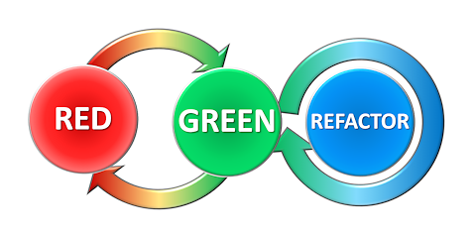

Slide 18
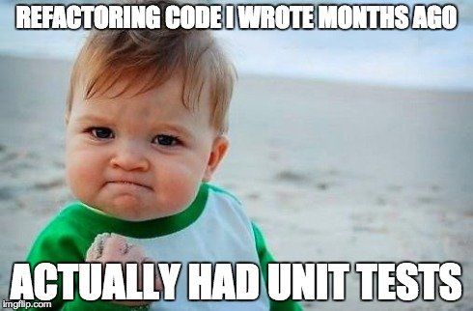

Slide 19
public class A
{
public class B
{
}
}

Slide 20
public class A : C
{
public class B : C
{
}
}
class C
{
}

Slide 21
C
Inheritance
A
B

